Slide 1
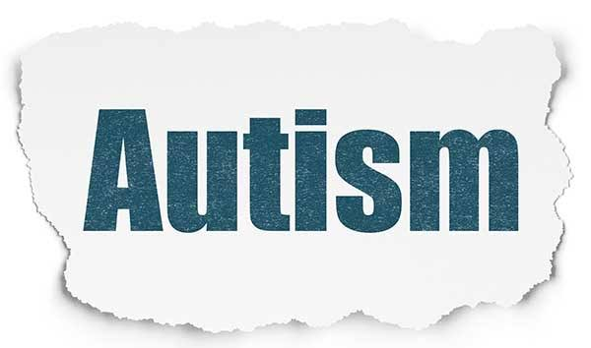
DETECTION OF AUTISM SPECTRUM DISORDER(ASD)
NEHA ACHARYA (20CS051)
PRATHUASHA K B (20CS058)

Slide 2
INTRODUCTION
Health care is one of the most important fields that would benefit from reducing processing time.
The speed and efficiency of human health issues diagnostics is significant.
The current diagnosing time is a huge challenge in many health conditions, especially Autism.

Slide 3

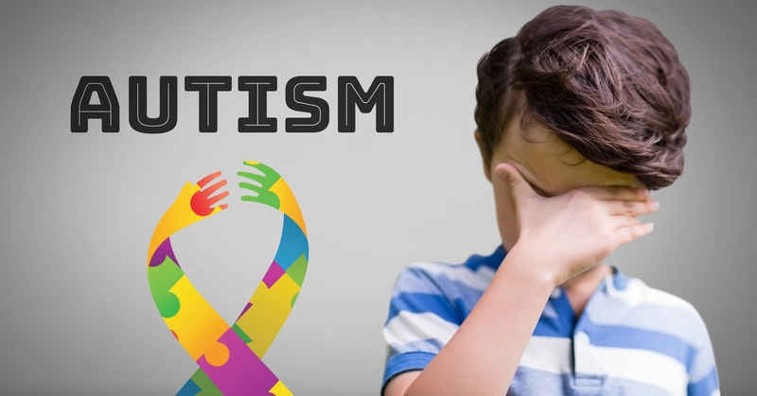

WHAT IS Autism Spectrum Disorder ??
Autism Spectrum Disorder (ASD) is a neurological and developmental disorder that begins in early childhood and lasts throughout a person’s life.

Slide 4
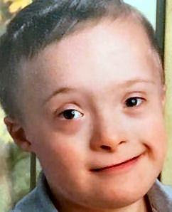
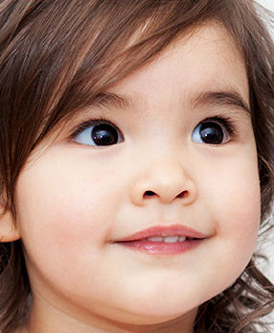
HOW AUTISTIC CHILDREN DIFFER FROM NORMAL CHILDREN?
Social Interaction - Struggle to interact with others.
Communication – Suffer with language development.
Sensory Sensitivity – More/less sensitive to stimuli.
Repetitive Behaviors – Engage in repetitive movements.
Flexibility – Struggle to adapt to changes.
Special Interests – Develop intense interests.
Emotional Expression – Difficult to express and understand emotions.
AUTISTIC CHILD
NORMAL CHILD

Slide 5
Problem statement & objective
Problem Statement
Objective
ASD is not curable.
Autism screening tests are both time- and money-consuming.
ASD detection involves developing accurate models to identify children with ASD based on their facial features, and social characteristics.
ASD detection is to enhance early and accurate detection of ASD by providing a free preliminary diagnostic tool that can aid parents in their decision to pursue further ASD testing.

Slide 6
planning
DATA ACQUISITION
LOAD DATASET
PREDICTION
COMPUTE RESULTS
MODEL DEPLOYMENT
TRAINING MODEL
MODEL FINE TUNING
TESTING MODEL

Slide 7

CONCLUSION & FUTURE WORK
CONCLUSION
Diagnosing autism is a difficult and expensive process. Fortunately, the correlation between facial features and autism means that a CV model can be trained to detect it.
FUTURE WORK
Future work is to train a model by using Brain-Imaging to detect ASD to retrieve more accurate results.

